Slide 1


Cassandra Introduction
Initialized by Facebook
http://planetcassandra.org/cassandra/

Slide 2
What is the name?
Came from the Greek character Cassandra who had the power of prophecy but no one believed her. I think the product is also supposed to run very fast and address all your problems but probably you will not believe unless you try it

Slide 3
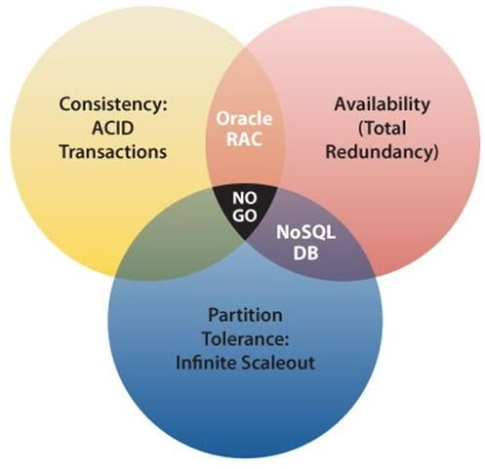

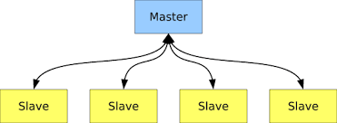
Cassandra vs HBase
Cassandra tech
Google’s Big Table
Amazon’s Dynamo(p2p)
HBase
CP
Cassandra
AP
Why Facebook finally choose HBase?
Architecture problem

Slide 4
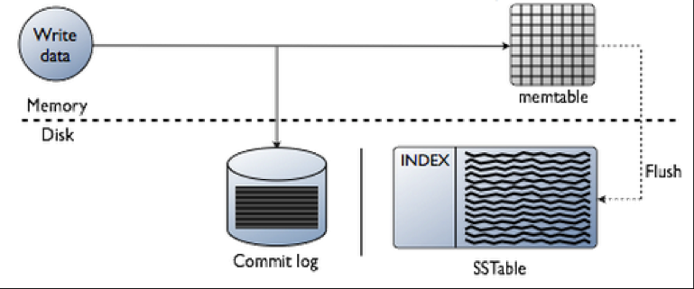
Cassandra Write & Read concept same with HBase
Write data

Slide 5
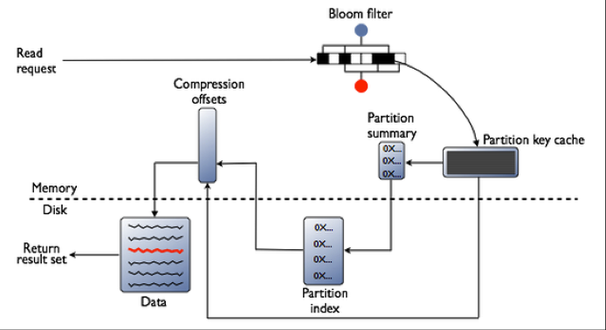
Cassandra
Read data
SST Table

Slide 6
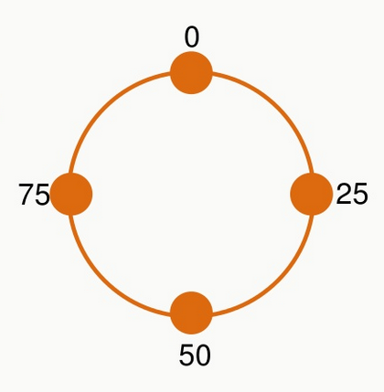
Data Distribution
Each node assign a unique token
Insert a new data
Grab the node token list from leader
Row key compare with tokens to decide data save position

Slide 7
Consistency & Replication
P2P consistency is a Big-Problem, unlike master-slave architecture
Consistency level
To solve consistency problem, divide many level
http://www.datastax.com/documentation/cassandra/2.0/cassandra/dml/dml_config_consistency_c.html
Write consistency level
Read consistency level
A replica factor = 3

Slide 8
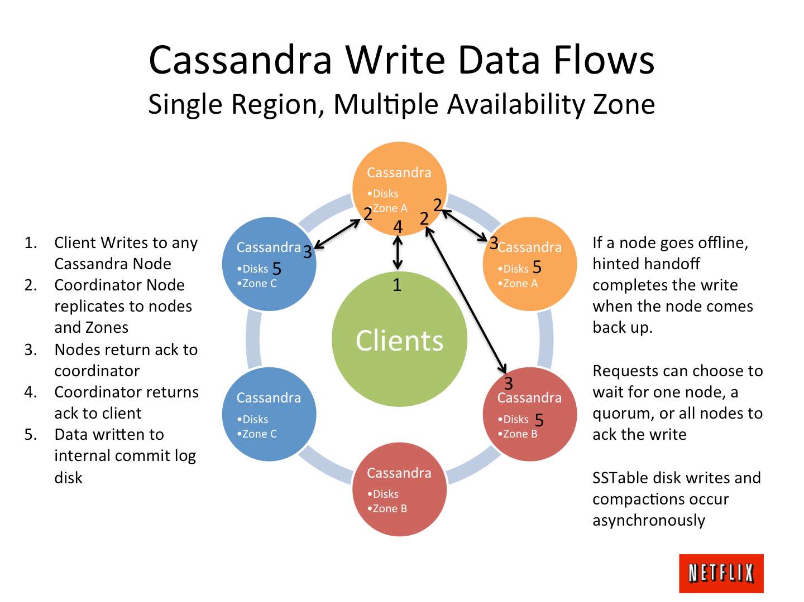
Single Region

Slide 9
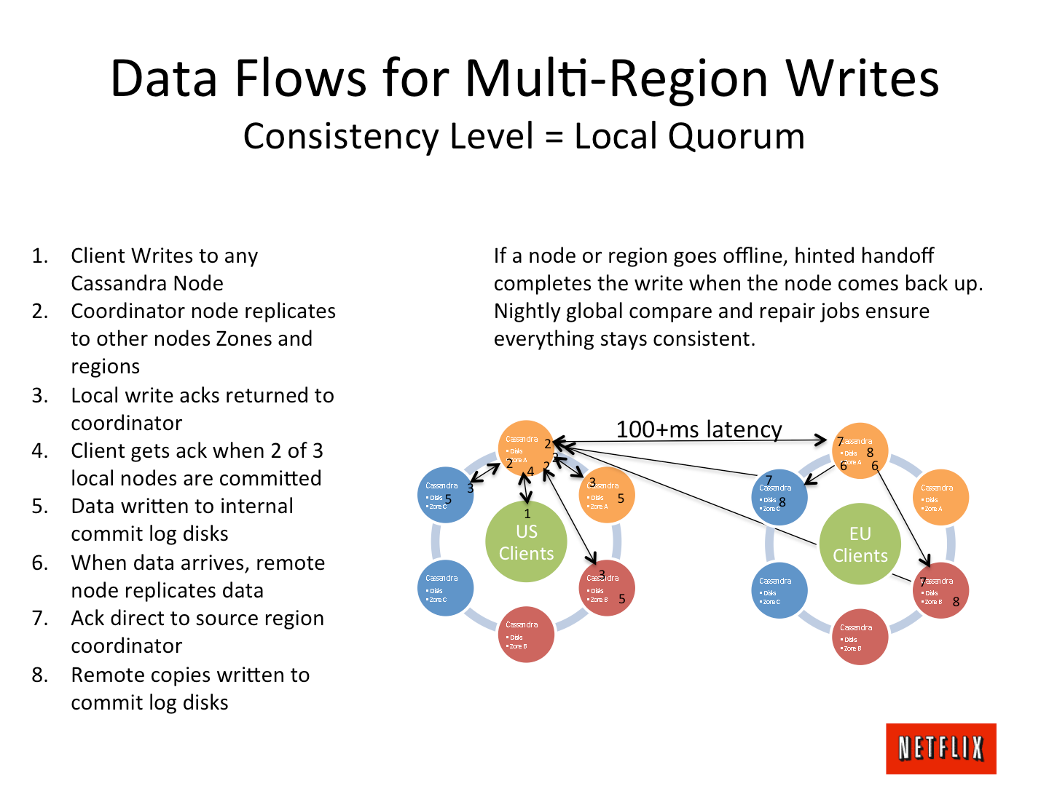
Multi Region

Slide 10
CQL Cassandra Query Language
No join, no constraint, no subquery
Demo
cqlsh

Slide 11
Cassandra benchmark
http://planetcassandra.org/nosql-performance-benchmarks/

Slide 12
Thanks for your attention

